Slide 1
Approximating the derivative using least-squares best-fitting polynomials

Slide 2
Introduction
In this topic, we will
Discuss how to estimate the derivative of data by using the least-squares best-fitting polynomials
Estimating or where
Describe the formula for both linear and quadratic polynomials
For the quadratic polynomial, we will also approximate the second derivative

Slide 3
Approximating the derivative
Suppose we have found the least-squares linear polynomial that passes through N equally-spaced points
The slope of the best-fitting linear polynomial we found was
Issue: this involved scaling, or dividing by h
Thus, the best approximation of the derivative is
y_{n}
y_{n–2}
a₁t + a₀
y_{n–1}
y_{n–4}
y_{n–3}
Here, N = 5
–4
–3
–2
–1
0

Slide 4
Approximating the derivative
Suppose we have found the least-squares quadratic polynomial that passes through N points
We found the coefficients of the least-squares quadratic polynomial a₂t² + a₁t + a₀ which has a derivative 2a₂t + a₁
At time t_{n}, the best estimate of the derivative is
At time t_{n} + δ h the best estimate of the derivative is
y_{n}
y_{n–2}
a₂t² + a₁t + a₀
y_{n–1}
y_{n–4}
y_{n–3}
Here, N = 5
–4
–3
–2
–1
0

Slide 5
Approximating the second derivative
Similarly, we can estimate the concavity with the formula
y_{n}
y_{n–2}
a₂t² + a₁t + a₀
y_{n–1}
y_{n–4}
y_{n–3}
–4
–3
–2
–1
0

Slide 6
Summary
Following this topic, you now
Understand how to estimate the derivative and second derivative of least-squares polynomials
Are aware that because our formula involved scaling, we must divide the derivative by the step size, and the second derivative by the step size squared
Understand that if we already have the coefficients, we can find these estimates in O(1) time

Slide 7
References
[1] https://en.wikipedia.org/wiki/Least_squares

Slide 8
Acknowledgments
None so far.

Slide 9
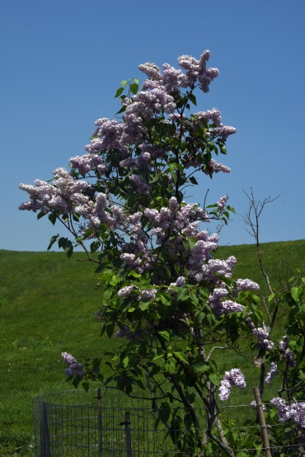
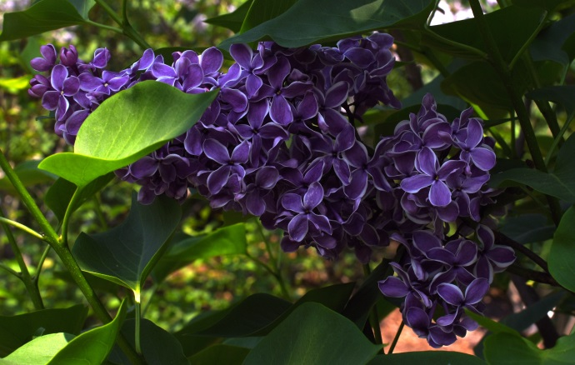
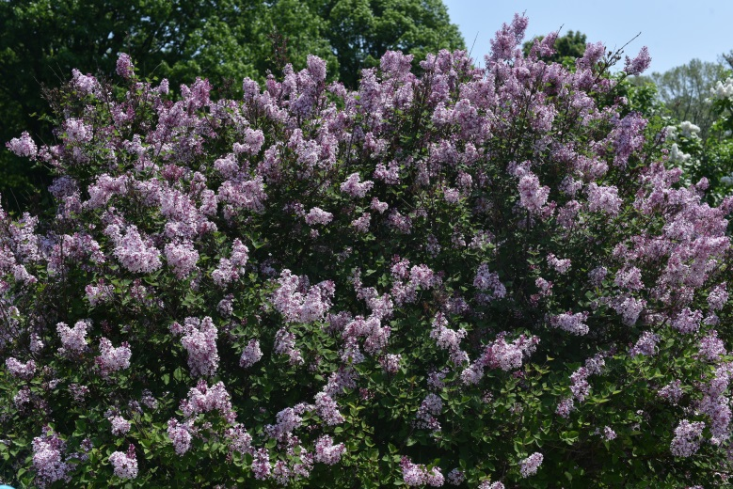
Colophon
These slides were prepared using the Cambria typeface. Mathematical equations use Times New Roman, and source code is presented using Consolas. Mathematical equations are prepared in MathType by Design Science, Inc.
Examples may be formulated and checked using Maple by Maplesoft, Inc.
The photographs of flowers and a monarch butter appearing on the title slide and accenting the top of each other slide were taken at the Royal Botanical Gardens in October of 2017 by Douglas Wilhelm Harder. Please see
https://www.rbg.ca/
for more information.

Slide 10
Disclaimer
These slides are provided for the ece 204 Numerical methods course taught at the University of Waterloo. The material in it reflects the author’s best judgment in light of the information available to them at the time of preparation. Any reliance on these course slides by any party for any other purpose are the responsibility of such parties. The authors accept no responsibility for damages, if any, suffered by any party as a result of decisions made or actions based on these course slides for any other purpose than that for which it was intended.

